Slide 1
$ lister
It makes lists

Slide 2
$ Lister
--what
Lister makes lists
adds items to lists
Removes items from lists
Saves lists
Loads lists that have been saved

Slide 3
$ Lister
--why
You’re working in a terminal, focused
  You have a great idea
    You fire up a text editor
      Your file is now lost in the abyss of
      “My Documents”
      …or the desktop

Slide 4
||

Slide 5
$ Lister
--why
You switch to your note-making app
  You fiddle with other ideas
  You play with formatting
    You start researching on the internet
    …You’re now scrolling social media

Slide 6
||

Slide 7
$ Lister
--why
You type:
$ lister -a “App Idea” “It makes lists”

Slide 8
$ Lister
--how
files = [ lister.rb, List.rb, State.rb ]
classes = [ List, State ]
require = [ psych, pastel, tty-prompt,
tty-font, bundler, rspec ]

Slide 9

$ Lister
--how
Courtesy of bbc
Two Modes:
  Interactive
  Linemode
Optional Third Mode:
  It speaks to you like Dave Lister

Slide 10
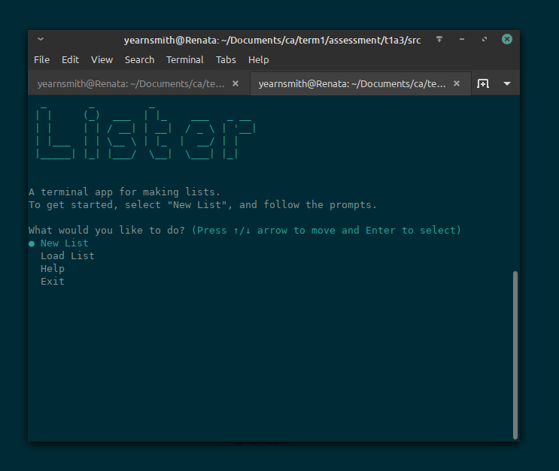
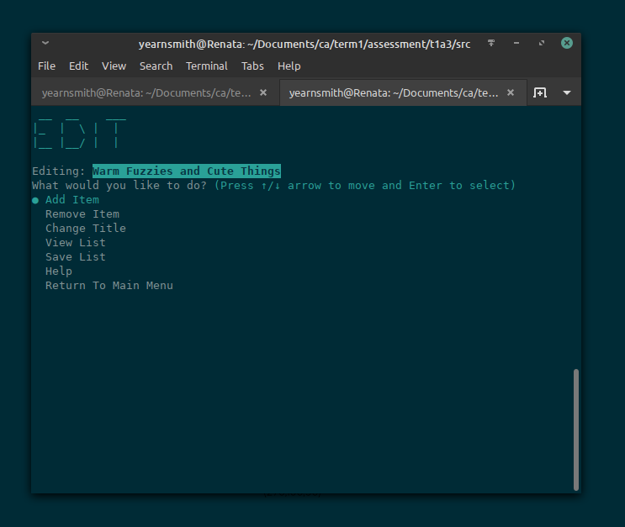
$ Lister
--how --Interactive

Slide 11
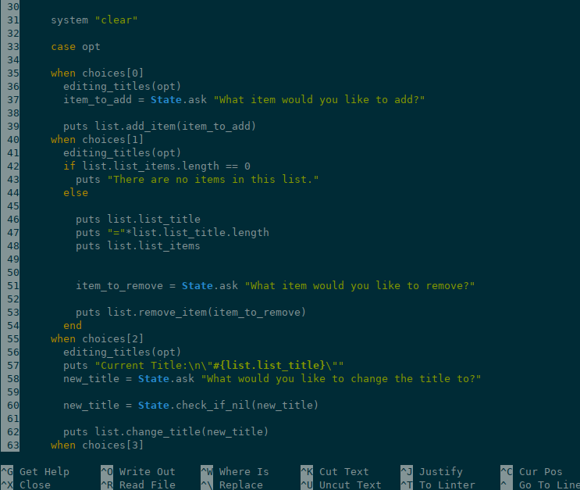
$ Lister
--how --Interactive
Lister.rb
(The main file)

Slide 12
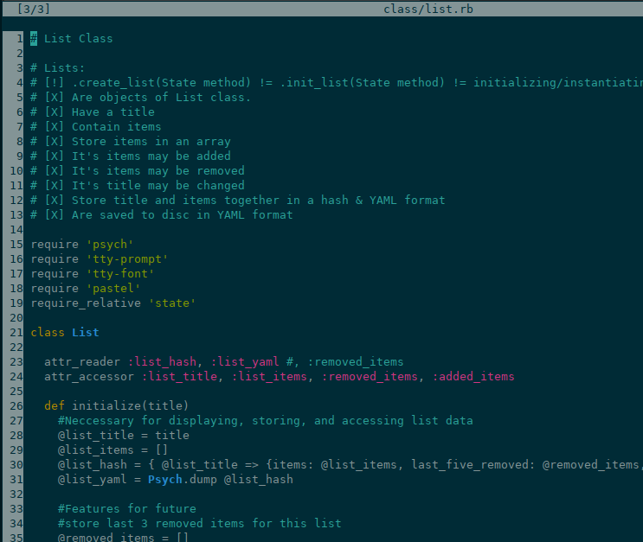
--how --Interactive
lists.rb
(The main class)

Slide 13
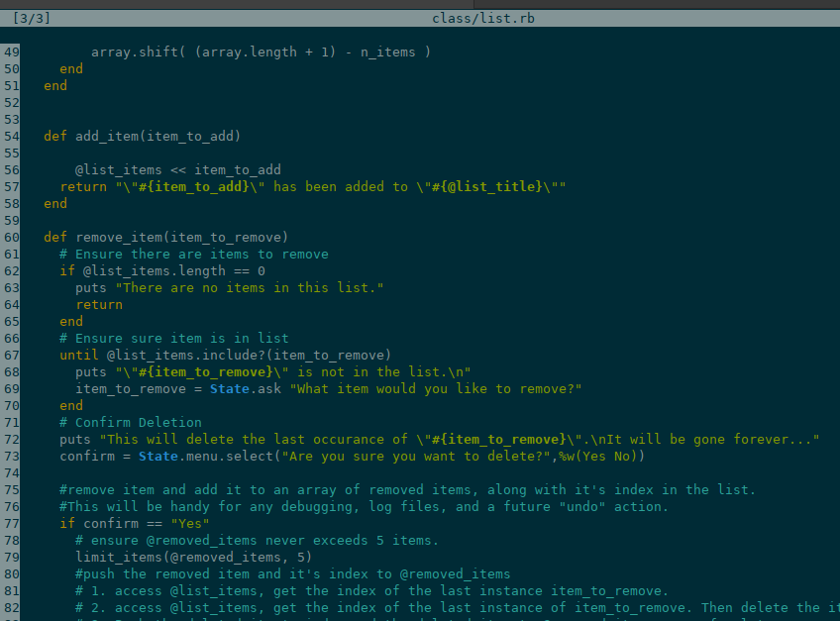
--how --Interactive
lists.rb
List methods giveth
And taketh away

Slide 14
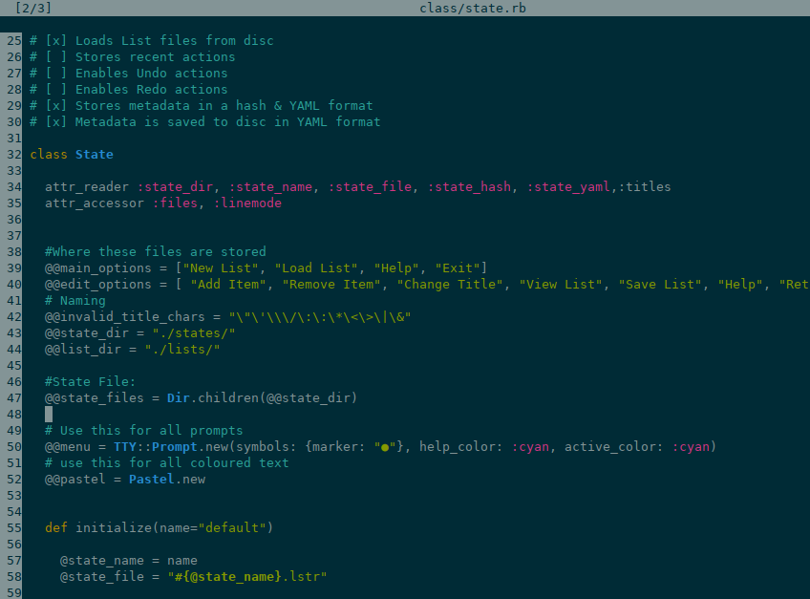
--how --Interactive
state.rb
(The other main class)

Slide 15
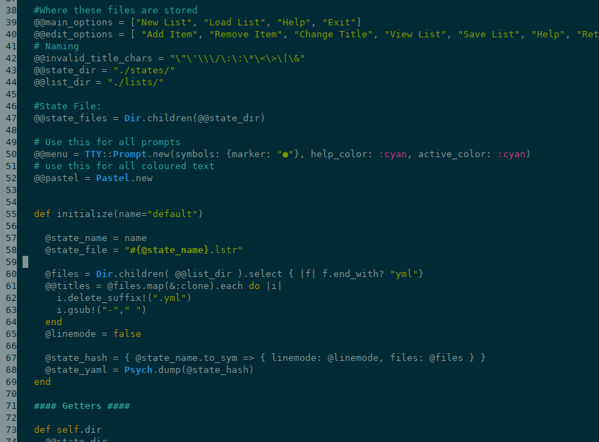
--how --Interactive
state.rb
Encapsulates
All the things

Slide 16
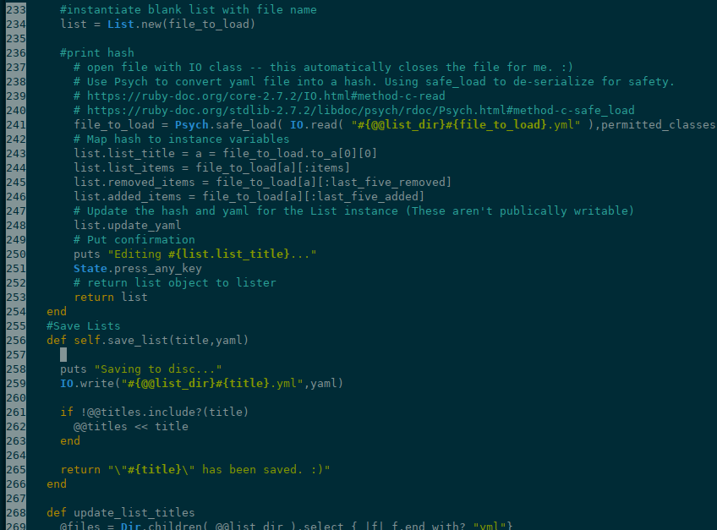
--how --Interactive
state.rb
Saves and loads lists
All the things

Slide 17
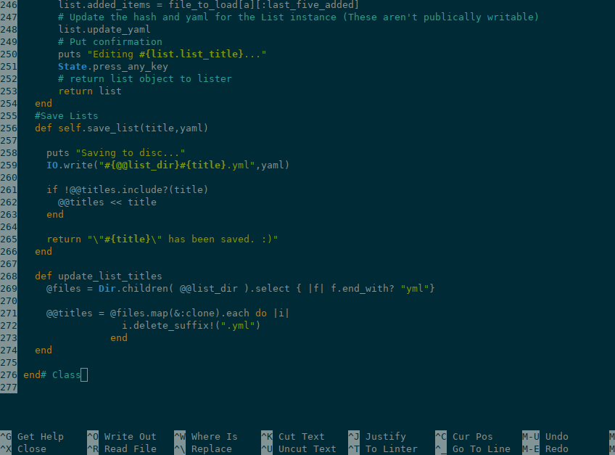
--how --Interactive
state.rb
Encapsulates
All the things

Slide 18
$ Lister
--Interactive
$ lister “App Idea” “It makes lists”
1 arguments
  open list
2 arguments
  open list
  add item

Slide 19
$ lister
Let’s make a list

Slide 20
$ Lister
--how
#!/usr/bin/bash
Cp files usr/bin/lister
# modify to if/elsif/else statement to find user’s .bashrc
Echo “alias lister=’usr/bin/lister/ruby lister.rb’” >> ~.bashrc
or
# will run as lister (but will it accept variables?)
#!/usr/bin/ruby
# ruby code goes here
#to run, type: ./ruby.rb

Slide 21
$ Lister
--linemode
$ lister --add “App Idea” “It makes lists”
$ lister --remove “App Idea” “It makes lists”
$ lister --echo “App Idea”
[ [-a , --add], [-r, --remove], [-e, --echo] ]

Slide 22
$ Lister
--challenges
Validation
  Loops!
    Multiple validation arguments don’t work
      Solving: Use TTY-prompt’s built in validation
Scope
  I underestimated the length of some tasks

Slide 23
$ Lister
--challenges
Validating file name… I learned some RegExp
Is my code modular?
  List class is accessing State class
  State class is accessing List class
Should I be modifying someone’s .bashrc?
  Should I just rename “lister.rb" to “lister”?

Slide 24
$ Lister
--To-do
Finish Triage
Convert loops to error handling
Add colours in validation
Fancify list titles etc.

